Slide 1


Slide 2
Applied physics
TOPIC OF DISCUSSION
INTRODUCTIUN TO ELECTRONICS
ENERGY BAND THEORY

Slide 3
ELECTRONICS
Electronics is a branch of physics and technology that is concerned with the design of circuits using transistors and microchips, and with the behaviour and movement of electrons in a semiconductor, conductor, vacuum, or gas¹
It also refers to circuits or devices using transistors, microchips, and other components¹

Slide 4
APPLICATIONS OF ELEECTRONICS
Electronics has a wide range of applications in various fields, including:
CONSUMER ELECTRONICS
DEFENSEAND AEROSPACE
INDUSTRIAL ELECTRONICS
INDUSTRIAL APPLICATIONS
COMMUNICATION AND ENTERTAINMENT
AUTOMOBILE INDUSTRY
TRANSPORT

Slide 5
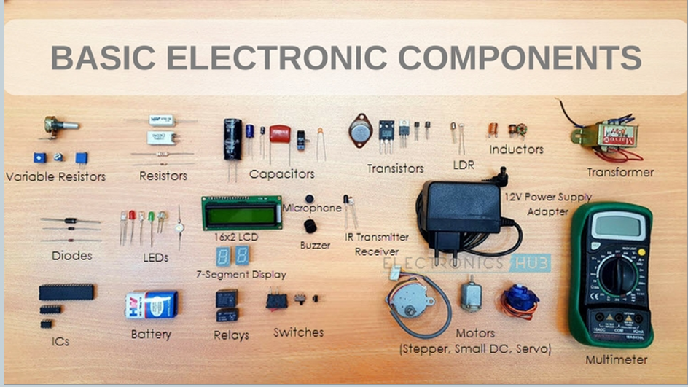
BASIC COMPONENTS OF ELECTRONICS

Slide 6
TYPES OF ELECTRONIC COPMPONENTS
There are 2 different types of electronics components
Active electronic components
that control the flow of current i.e diodes and ic^s
Passive electronic components
they cannot conr decrease themtrol the flow of current but increase ordecrease current i.e resistors capacitors and inductors

Slide 7
Topic 2: energy band theory
The conventional free electron theory based on Bohr’s atomic model of electron distribution in an atom failed to explain completely vast diversity in electrical behaviour of conductors, insulators and semi_conductors.
On the other hand, energy band theory based on wave mechanical model given by Schrodinger has found successfully in resolving the problem.

Slide 8
Postulates
This theory explains that how electrons are distributed across energy levels or bands.
This theory demonstrates that in crystalline solid, the electrons are not confined to individual energy levels as in isolated atoms, but form energy bands.
These bands include valence bands and conduction bands.

Slide 9
Forbidden energy gap
There is also a forbidden energy gap between two consecutive permissible energy bands where there is a range of energy which can not be occupied by electrons.
This forbidden energy gap depends on specific properties of material and its atomic structure

Slide 10
Types of energy bands
Valence band
The highest occupied band is called as valence band.
The electrons occupied by the outermost shell of an atom are called valence electrons.
Valence band can be either completely or partially filled.
Valence band can never be empty.
The electrons in valence band are less energetic and they not take part in conduction.

Slide 11
The reason behind this is that of atomic positions, effects of electron repulsion and their role in chemical bonding.
This lower energy prevents them from moving freely through the crystal lattice and so they remain localized around their respective atoms.

Slide 12
Conductance band
The band above the valence band that contains electrons which are responsible for the flow electric current through solids is called conduction band.
The electrons occupied by conduction band are called conductive or free electrons.
It may be empty or partially filled.
It can not be completely filled.

Slide 13
Benefits of energy band theory
The energy band theory helps us to understand the behavior of solids on the basis of their conductivity.
On basis of conductivity . Solids are divided into classes
Conductors
insulators
Semi conductors

Slide 14
Insulators
Insulators are those materials in which electrons are not free for conduction. According to this theory, insulators are those materials which have;
Empty conduction band.
A full valance band.
A large energy gap is present between both bands of several electron volts(eV).

Slide 15
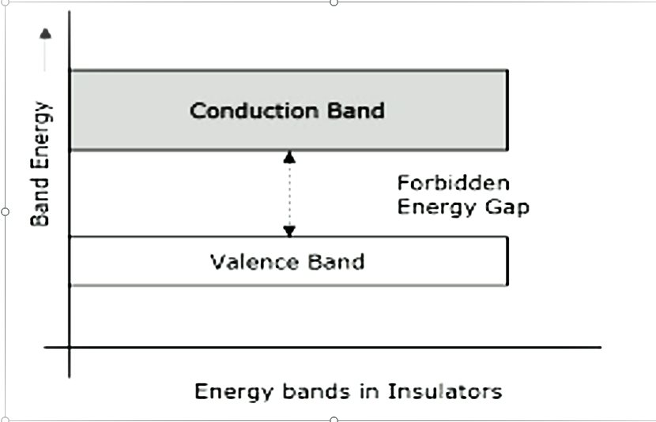
VISUALIZATION OF BANDS IN INSULATORS

Slide 16
CONDUCTORS
Those materials which have plenty of free electrons for conduction are called conductors. According to this theory, conductors are those materials which have;
Valence band and conduction bands overlap each other.
No physical distinction between two bands which ensures availability of large number of free electrons.

Slide 17
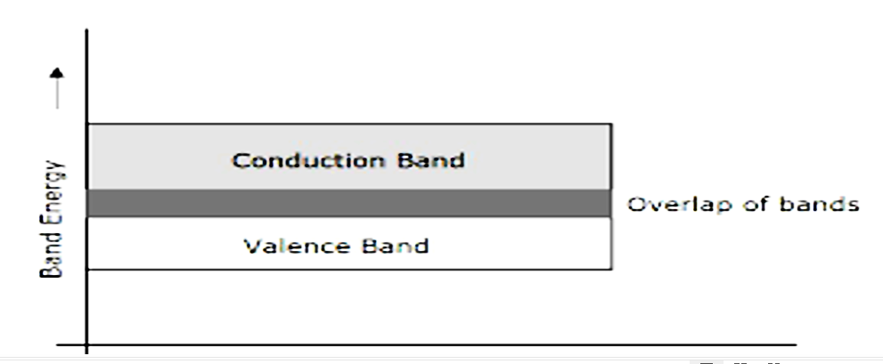

Slide 18
SEMI CONDUCTORS
Those materials whose properties lies in between conductors and insulators are called semi conductors. According to energy band theory, semi conductors are those materials which are at room temperature;
Partially filled conduction band.
Partially filled valence band.
Narrow forbidden gap of order of 1eV.

Slide 19
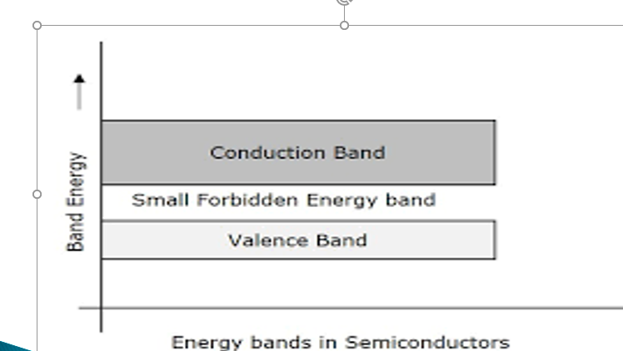
SEMI CONDUCTORS

Slide 20

VISUALIZATION OF EBT

Slide 21
EFFECT OF TEMP ON SEMI CONDUCTORS
At 0K, there are no electrons in the conduction band and their valence bands are completely filled. This means that at 0K, a piece of Germanium or Silicon is a perfect insulator.
However with the increase in temperature electrons jump from valance band into conductive band after crossing the narrow forbidden gap by leaving vacancies in the valance band. Thus conduction increases gradually with increase in temperature.

Slide 22
LIMITATIONS IN ENERGY BAND THEORY
The drawbacks of EBT are given below
It is only applicable for to crystalline solids where the periodic lattice is well defined .It does not work well for amorphous or disordered shaped molecules.
EBT assumes a perfect crystal lattice ignoring the presence of any impurities in it.
EBT is often a static model and does not address dynamic electron behaviors such as response to external forces or fields.
EBT become less accurate at nano scale where quantum effects play a significant

